Slide 1
Patient data on the role of epithelial cytokines in eosinophilic esophagitis (EoE)
Learn more about the role epithelial cytokines play in EoE

Slide 2
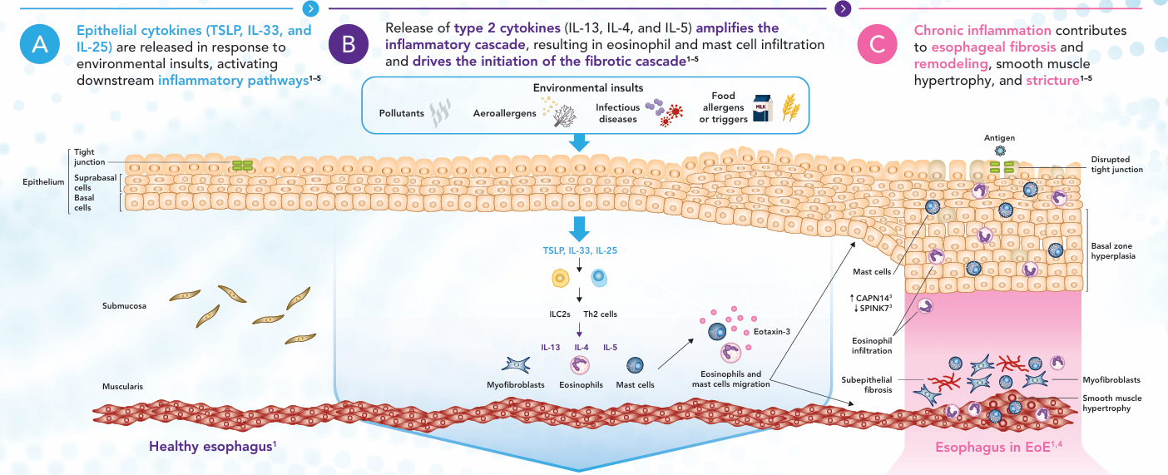
Esophageal epithelial-driven inflammation drives EoE
CAPN14, calpain 14; EoE, eosinophilic esophagitis; IL, interleukin; ILC2, type 2 innate lymphoid cell; SPINK7, serine peptidase inhibitor, kazal type 7; Th, T helper; TSLP, thymic stromal lymphopoietin
1. Berni Canani R, et al. Allergy. 2024;79(6):1485–1500; 2. Farah A, et al. Diagnostics (Basel). 2025;15:240; 3. Underwood B, et al. Ann Allergy Asthma Immunol. 2023;130:28–39; 4. Laky K, et al. J Allergy Clin Immunol. 2024;153:1485–1499; 5. Jensen ET, et al. J Allergy Clin Immunol. 2018;142:32–40.

Slide 3
Epithelial cytokines are overexpressed in patients with EoE
Esophageal biopsies from patients with EoE show significantly higher epithelial cytokine expression than healthy controls^{1–3}
TSLP¹*
IL-33¹*
IL-25¹*
2.0
P=0.0001
2000
P=0.023
2000
P=0.0006
P=0.0001
P=0.019
P=0.0005
1.5
1500
1500
1.0
1000
1000
Score
Cells/mm²
Cells/mm²
0.5
500
500
0
Proximal
Distal
Proximal
Distal
0
Proximal
Distal
Proximal
Distal
0
Proximal
Distal
Proximal
Distal
Normal esophagus (n=3)
Active EoE (n=10)
Normal esophagus (n=3)
Active EoE (n=10)
Normal esophagus (n=3)
Active EoE (n=10)
Figures adapted from Simon D, et al. Allergy 2015;70:443–452 *Anonymized tissue samples from 18 patients with active EoE were analyzed. The presence of DNA nets associated with eosinophil granule proteins forming EETs and the expression of ﬁlaggrin, antimicrobial peptides, and cytokines were evaluated by confocal microscopy following immune ﬂuorescence staining techniques. TSLP expression was calculated using an ordinal scoring system (0 = none, 1 = mild, 2 = medium, 3 = strong, 4 = very strong) to represent how widely the cytokine marker was expressed in tissue sections, while nuclear expression of IL-33 and IL-25 expression was calculated by counting the number of infiltrating cytokine-positive cells in the area¹ DNA, deoxyribonucleic acid; EETs, eosinophil extracellular traps; EoE, eosinophilic esophagitis; IL, interleukin; TSLP, thymic stromal lymphopoietin 1. Simon D, et al. Allergy. 2015;70:443–452; 2. Chandramouleeswaran PM, et al. PLoS One. 2016;11:e0150968; 3. Travers J, et al. Sci Rep. 2017;7:17563.

Slide 4
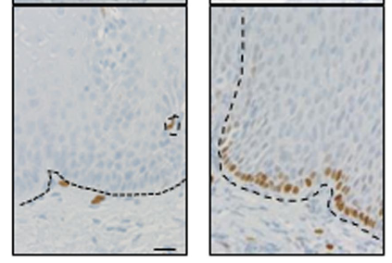
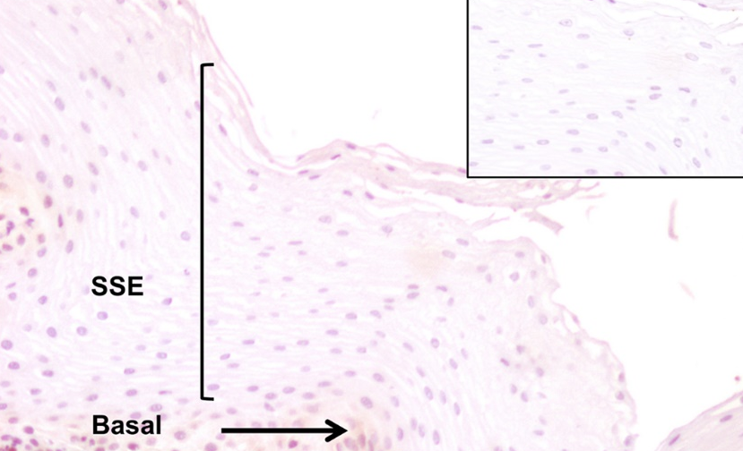
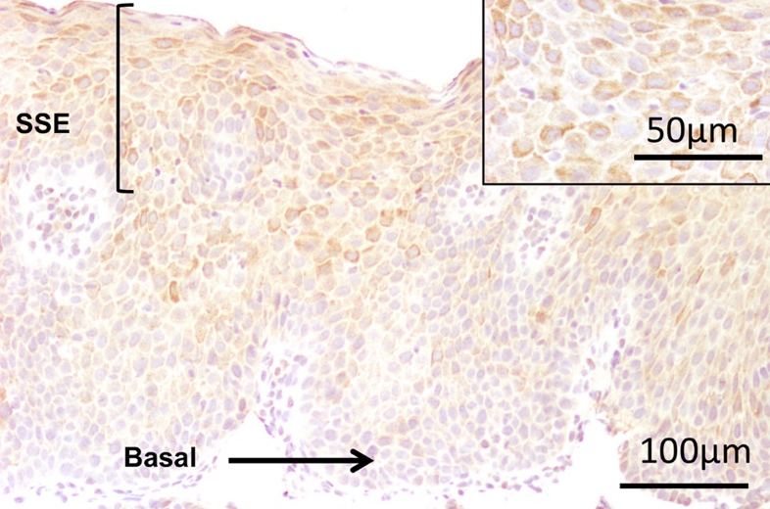
Epithelial cytokines are overexpressed in patients with EoE (continued)
Esophageal biopsies from patients with EoE show significantly higher epithelial cytokine expression than healthy controls^{1–3}
TSLP expression in the suprabasal differentiated compartment of the esophageal epithelium of pediatric patients²*
IL-33 localization in esophageal basal epithelial cells³
Control
Active EoE
Control
BM
Active EoE
Interpapillary basal layer
BM
Epithelium
Immunohistochemistry: cells expressing TSLP stain brown
Immunohistochemistry: cells expressing IL-33 stain brown, dashed line indicates basement membrane
Images from Chandramouleeswaran PM, et al. PLoS ONE 2016;11:e0150968 and Travers J, et al. Sci Rep 2017;7:17563
*TSLP expression was characterized in human esophageal epithelium in EoE in vivo and to determine the role of food antigens upon epithelial TSLP expression in vitro. Using immunohistochemistry, TSLP was localized in esophageal biopsies of active EoE (≥15 eos/hpf), inactive EoE (<15 eos/hpf) and non-EoE control subjects² BM, basement membrane; EoE, eosinophilic esophagitis; eos/hpf, eosinophils per high-powered field; IL, interleukin; SSE, stratified squamous epithelium; TSLP, thymic stromal lymphopoietin 1. Simon D, et al. Allergy. 2015;70:443–452; 2. Chandramouleeswaran PM, et al. PLoS ONE. 2016;11:e0150968; 3. Travers J, et al. Sci Rep. 2017;7:17563

Slide 5


Genetic TSLP polymorphisms are observed in patients with EoE
TSLP polymorphisms associated with EoE
Cells that express TSLPR
Mechanism of TSLP-induced signaling⁶
In patients with EoE, genomic analyses have identified polymorphisms associated with:
Dendritic cells
TSLP
TSLPR
IL-7Rα
TSLP^{1-3*}
TSLPR²
CD4+ T cells
A genome-wide association study identified the 5q22 locus, a region that harbors the TSLP gene, as a risk locus for EoE susceptibility^{1,2}
B cells
JAK2
JAK1
Elevation of TSLP expression in EoE
Mast cells
STAT5
STAT5
Overexpression of several critical genes, including TSLP, was found to disrupt the esophageal barrier and enhance immune-mediated inflammation⁴
Variants in the genes encoding the alarmin TSLP are associated with increased risk of developing EoE; TSLP expression is increased in biopsy samples from patients with EoE⁵
Eosinophils
IL-4
IL-5
IL-9
IL-13
Innate lymphoid cells
Nucleus
*There are currently no literature findings which identify well-established polymorphisms in the IL-33 or IL-25 genes associated with EoE susceptibility
EoE, eosinophilic esophagitis; IL, interleukin; TSLP, thymic stromal lymphopoietin; TSLPR, thymic stromal lymphopoietin receptor 1. Rothenberg ME, et al. Nat Genet. 2010;42:289–291; 2. Sherrill JD, et al. J Allergy Clin Immunol. 2010;126:160–165; 3. Kottyan LC, et al. Nat Genet. 2014;46:895–900; 4. Ryu S, et al. Int J Mol Sci. 2020;21:7253; 5. Laky K, et al. J Allergy Clin Immunol. 2024;153:1485–1499; 6. Ebina-Shibuya R, et al. Nat Rev Immunol. 2023;23(1):24-37

